Slide 1
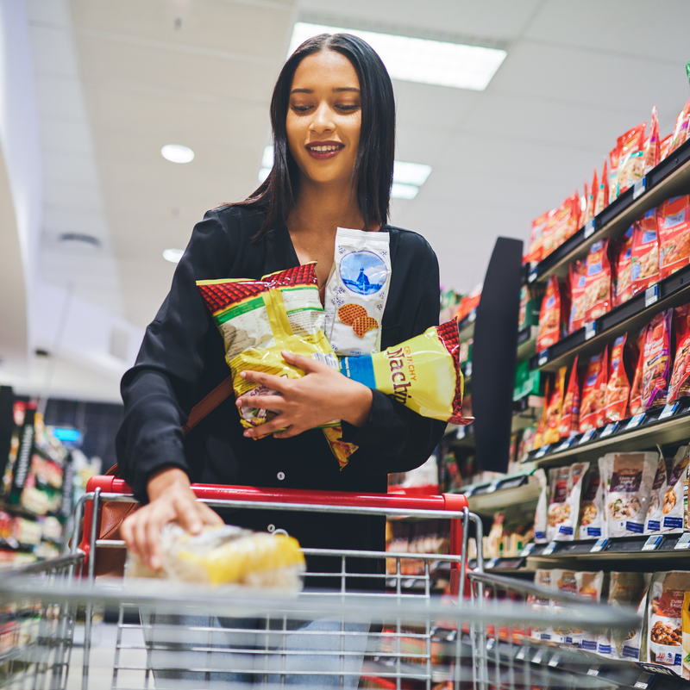
From Retailer Shoppers to Category Buyers
A case study on one retailer’s journey to leveraging shopper-based strategies to grow the snack category

Slide 2
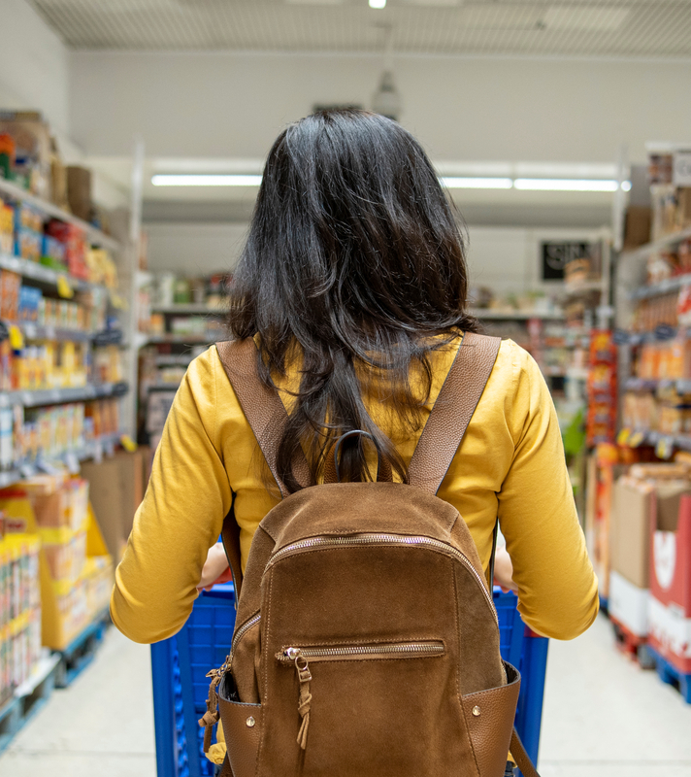
Background
Retail-Mart seeks to understand shopper attitudes, preferences, influences, and behaviors for the snack category shopper, at both Retail-Mart’s and key competitors
For this analysis, insight from NIQ BASES Omnichannel Shopper Fundamentals and Store Choice Drivers solutions was used to develop a shopper led strategy for the snacks category

Slide 3
Shopper-based Intelligence
Omnichannel Shopping Fundamentals
Path to purchase insight
130+ Food and Non-Food categories
Analyze across pre-trip, trip, post-trip attitudes,
Assess behaviors, and purchase influencers, both in-store and online
Store Choice Drivers
Shopper ratings of retailer performance
8 key measures of shopper engagement
50+ performance attributes
Identifies individual retailer’s strengths, weaknesses, and opportunities based on shoppers’ attitudes

Slide 4

Key business questions to be answered by Store Choice Drivers and Omnichannel Shopping Fundamentals
Omnichannel Shopping Fundamentals can tell you
Store Choice Drivers can tell you
 | How do shoppers rate Retail-Mart's performance overall? How do they compare to key regional competitors?
 | How loyal are Retail-Mart's shoppers? Are shoppers willing to be inconvenienced compared to competitors?
 | Do Retail-Mart's shoppers view their snack selection positively? How important is it to have a good snack selection?
 | Is the snack category an impulse or planned purchase?
 | How engaged with the snack category are shoppers?
 | What are the key in-store influencers of snack category shoppers?
 | Is price or quality more important to shoppers?
 | What kind of trip (Quick trip, Fill-in, Stock up) is most likely?
 | Where in the store is the snack category purchased?
 | How can Retail-Mart partner with manufacturers to bring shoppers back to the snack category?

Slide 5

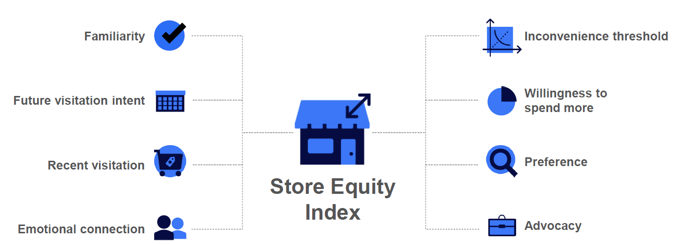
How does Retail-Mart stack up against their competition?
Store Equity Index can tell Retail-Mart how shoppers view their strengths and weaknesses
Key Insights
Store Equity Index shows retailer performance on eight key shopper metrics
Retail-Mart’s Store Equity Index of 80.18 trails most retailers, but outperforms some key competitors
Retail-Mart performs well on familiarity, visitation, and loyalty
Retail-Mart underperforms the market in future visitation intent and advocacy
Eight Factors: Familiarity, future visitation intent, recent visitation, emotional connection, inconvenience threshold, willingness to spend more, preference and advocacy. All Brick & Mortar retailers are indexed against each other, and all E-commerce retailers and Retailer.com sites are indexed against each other. Each retailer, e-commerce retailer, or Retailer.com site receives only one equity score – the score does not reindex if a new comparison group is created.

Slide 6
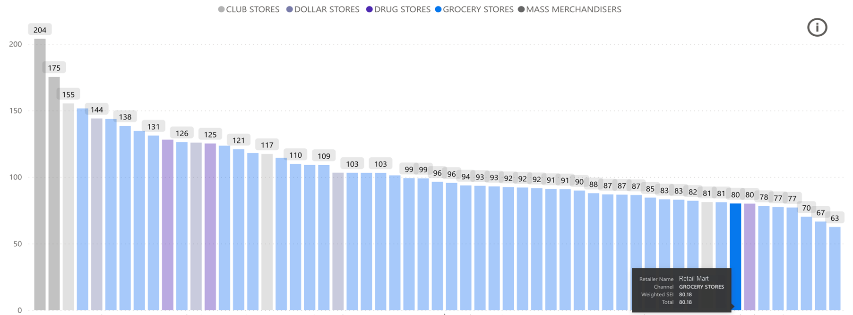
As we can see, Store Choice Drivers provides Retail-Mart a detailed view into their store equity index relative to competitors
Store Equity Index
Source: 2023 BASES Shopper Solutions Store Choice Drivers, Store Equity Index

Slide 7
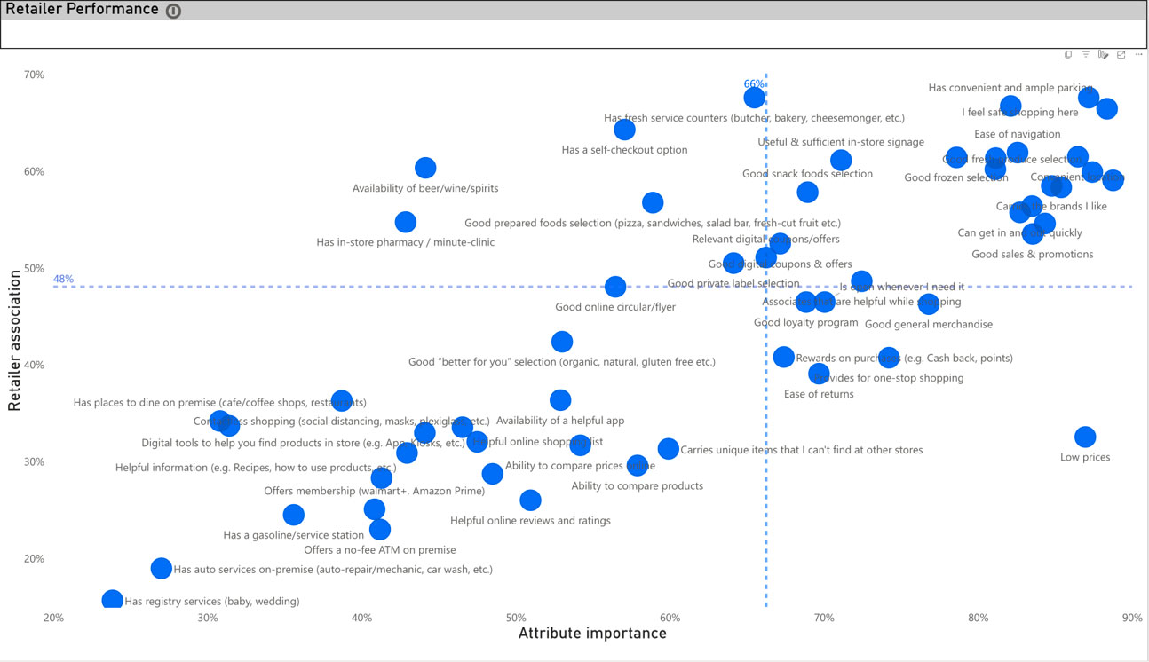
The dashboard also enables a seamless view into Retail-Mart's strengths and potential weaknesses in the eyes of their shoppers
Key Insights
Retail-Mart’s Strengths
Having a good selection of snacks is of above-average importance to Retail-Mart’s shoppers Shoppers perceive Retail-Mart as doing better than the overall market on “has a good selection of snacks” While shoppers give Retail-Mart credit for snacks, it could be improved as a strength
Implications
The snack category is a “table stakes” category for Retail-Mart given its importance to shoppers and shoppers’ favorable view of Retail-Mart’s snacks category By featuring the snacks category more prominently in store, Retail-Mart is both meeting shopper expectations and creating additional revenue opportunities
Source: 2023 Store Choice Drivers, Retail-Mart’s Retailer Performance Attribute Quadrant

Slide 8






At-a-glance, the analysis shows us where is Retail-Mart excels
Compared with snack category shoppers overall, Retail-Mart’s snack category shoppers are more likely to…
Purchase on impulse
Retail-Mart: 43%
Study Average: 33%
Engage with category
Retail-Mart: 68%
Study Average: 61%
Be influenced by
deals and displays
Retail-Mart: 33%
Study Average: 17%
Balance Price & Quality
Retail-Mart: 43%
Study Average: 40%
Shop on a quick trip
Retail-Mart: 56%
Study Average: 48%
Purchase at front end
Retail-Mart: 18%
Study Average: 9%

Slide 9
Retail- Mart shoppers are...
Snack category purchase type
Impulsive and Engaged
Snack category purchase type
Implication:
Retail-Mart has an above-average opportunity to engage shoppers and convert them to snack category buyers in impulse-heavy areas of the store.
Planned vs Impulse: “In regard to this recent purchase, when did you decide to buy it? I knew that I was going to purchase this product before I went to the store, I realized that I needed the product while I was in the store, or I had not planned to purchase this product and purchased it on impulse”
Engagement vs Auto Pilot: Which of the following do you recall happening while shopping for the product? I went straight for the product I intended to purchase/usually purchase = Autopilot. 1- Autopilot = Engaged (not on Auto Pilot)

Slide 10
Retail- Mart shoppers are...
Snack category point of purchase influencers
Influenced by Deals
and Displays
Implication:
Displays featuring product on deal will appeal to the Retail-Mart snack category shoppers.
Which of the following do you recall happening while shopping for this product? See appendix for complete answer set choices.

Slide 11
Retail- Mart shoppers are...
Snack category price to quality spectrum
Committed to quality and are shopping for others
Snack category purchase autonomy
Implication:
Price is important to Retail-Mart’s snack category shoppers, but they are not willing to sacrifice quality for price. They're also more likely to be purchasing for the household.
Price vs. Quality: ”Please Indicate which of the following statements best describe how you purchase this product. 1 = I always look for the lowest price, 5 – I am willing to pay more for premium or high-quality products”
Decision Autonomy: “Please indicate which statement best describes how you purchase the product? 1 = The decision is NOT entirely up to me 5 = The decision is entirely up to me

Slide 12
Retail- Mart shoppers are...
Snack category purchase location
In a rush and still shopping while
checking out
Snack category trip type
Implication:
Place the snack category at the front of store where it is easy for shoppers to see, engage and purchase snacks. Consider proximity to self-checkout and express lanes for shoppers on quick trips.
Which of the following do you recall happening while shopping for this product? See appendix for complete answer set choices.

Slide 13

When you understand how your shoppers view you, and how they want to shop, you can cater every element of the shopping experience to your goals.

Slide 14
Turning data-based insights into actionable business strategies
Are loyal but with low tolerance for being inconvenienced or paying more
Actionable strategies
For Retail-Mart – more so than competitors – “getting it right the first time” and providing shopper value are critical to retaining loyalty.
Leverage the snack category as a key driver of sales.
Locate the snack category in high visibility areas in-store; once shoppers see the category, they engage.
Use a combination of deal + display to maximize shopper response. Prioritize assortment over depth of deal. Offer loyalty/reward element.
  Example: Buy A, Get B promotion where shoppers could buy different varieties would be more appealing to Retail-Mart’s shoppers than a deep deal on a single item.
Locate displays at front of store, in proximity to self-checkout and express lanes if possible.
Say that a good selection of snacks is important to their choice of store and consider Retail-Mart’s snack selection above average
Are more likely to purchase snacks on impulse than shoppers overall
Engage with the snack category at a higher rate than shoppers overall
Retail-Mart's shoppers...
Are 2x as likely to be influenced by deals and displays than shoppers overall
Desire a balance of price and quality
Are more likely to be purchasing for others in addition to themselves​
Are more likely to be shopping on a quick trip and find snacks to buy at front end/checkout

Slide 15
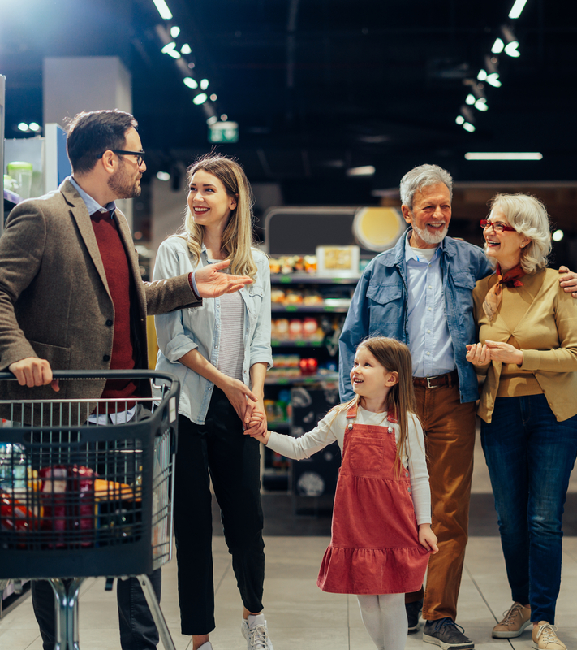

Our New Reality
The way consumers decide where to shop has changed. Emotional connections are more important, sensitivity to price has hit an all-time high, yet shoppers will go out of their way to get what they want (for the right price.) Retailers that capitalize on these trends are being rewarded with not only loyalty, but advocacy.
Contact a store choice expert today

