Slide 1
COVID-19 Impact on J&J Consumer Shopping Trips
Q4 2021 + Full Year 2021 Review
Data WE 1-1-22 vs YA

Slide 2
What’s happened since our last update…
The US recorded its first Omicron case on December 1st, the newest variant of COVID-19
“The spread of the highly infectious omicron variant is likely to fuel more inflation, as Americans keep shopping instead of spending more outside of the home…Little is certain about omicron’s impact on consumer demand, but people who stay at home because of the variant are more likely to spend their money on retail goods rather than services like dining out or in-person entertainment.” - CNBC
However, “rising infection rates driven by the faster-spreading Omicron variant of Covid-19 led to a U.S. and global economic slowdown as the year got under way…The U.S. services and manufacturing sectors suffered from supply issues and labor shortages attributed to the surge in cases from the Omicron variant. Businesses reported that they had raised their prices at a faster rate than over recent years.” – Wall Street Journal
The unemployment rate fell to 3.9% in December, with wage growth accelerating
The Labor Department’s report showed the employment population ratio -- or the percentage of the population that is currently working -- increased to 79% in December among those ages 25-54. That was the highest since March 2020. - Bloomberg
In the US, 74.5% of the population has received at least one dose of the COVID vaccine, while 62.7% are fully vaccinated (22.1% of which has received a Booster) as of 1-1-22*
Notes:
*per Our World in Data, https://ourworldindata.org/covid-vaccinations?country=USA
CNBC article: https://www.cnbc.com/2022/01/05/omicron-variant-likely-to-fuel-inflation-as-americans-keep-shopping-economist-says.html
WSJ article: https://www.wsj.com/articles/omicron-slows-europes-economy-but-supply-chain-strains-ease-11643023131
Bloomberg article: https://www.bloomberg.com/news/articles/2022-01-07/u-s-adds-fewer-jobs-than-forecast-unemployment-rate-falls

Slide 3
Total Trips

Slide 4
Shoppers made more J&J trips in Q4 21 vs YA, however trips are down compared to Q3 21; J&J trip growth outpacing that of Total Category
J&J Trips – Total US
Trips % Chg.
vs. YAGO
J&J Cat Set | +1.9% | +9.4% | -1.3% | -1.3% | -2.8% | -9.8% | +5.0% | +5.0% | +3.7%
J&J | +2.5% | +12.7% | -1.3% | -0.1% | -1.7% | -11.9% | +9.4% | +10.7% | +7.3%
Source: Nielsen Homescan Panel Trip Projection, Total J&J, Total US, L13 WE 1-1-22 vs YAGO

Slide 5
Self Care drove the greatest J&J trip growth in Q4 21, with six J&J categories outpacing Total Category trip growth
J&J Trips % Change vs YAGO – Total US
Total Category Trips % Chg. | +3.7% | +25.4% | +1.8% | +1.0% | +3.6% | -0.9% | +41.3% | -8.9% | -7.2% | +3.9%
J&J outpacing Total Category
Source: Nielsen Homescan Panel Trip Projection, Total US, L13 WE 1-1-22 vs YAGO

Slide 6




J&J grew trips in all major channels aside from Total Online and Club
Drug retailers driving J&J trip growth in Q4 21 and outpacing Total Category Set, COVID vaccines and booster availability are a factor; overall J&J spend per trip growing again
Total J&J
Total Category Set
 | Trips % Chg | $ per Trip | $ per Trip % Chg | Trips % Chg | $ per Trip | $ per Trip % Chg
Total US | +7.3% | $9.99 | +1.5% | +3.7% | $11.84 | +4.8%
 | +23.7% | $12.30 | -1.5% | +17.9% | $16.69 | +1.7%
 | +17.2% | $12.56 | +0.5% | +14.1% | $17.79 | +3.8%
Total Food | +8.8% | $9.01 | +4.9% | +3.1% | $8.39 | +5.1%
 | +8.5% | $9.20 | -2.0% | +10.8% | $13.68 | +5.7%
Total Dollar | +6.7% | $6.16 | +8.5% | -4.8% | $5.34 | +7.7%
 | +6.5% | $8.51 | +2.0% | +3.9% | $11.78 | +6.4%
Total Online | -1.4% | $13.11 | +3.7% | +3.5% | $18.70 | -0.8%
Total Club | -2.9% | $16.97 | -2.1% | -4.7% | $22.38 | 0.0%
Aside from Total Online, Retailers are primarily defined as B&M in Panel
Source: Nielsen Homescan Panel Trip Projection, L13 WE 1-1-22 vs YAGO

Slide 7
POS data validates the same Drug store trends for J&J
Sales % Chg vs YA – Total J&J
Source: NielsenIQ data. J&J Database. Product: Total J&J

Slide 8
Consumer Spotlight

Slide 9
Asian, White, and African American households drove J&J trips in Q4 21, with all groups making more repeat J&J purchases
J&J Trips % Chg by Race/Ethnicity
J&J Buy Rate & Repeat Rate by Race/Ethnicity
 | $ per Trip | $ per Trip % Chg | % Repeat Rate | % Repeat Rate Chg
White | $9.87 | +1.1% | 56.7 | +2.8%
African American | $9.87 | +7.4% | 58.9 | +3.7%
Asian | $10.59 | -4.4% | 54.9 | +3.5%
Other Race | $10.73 | +0.1% | 56.9 | +2.4%
Hispanic | $10.55 | +4.7% | 57.5 | +2.1%
Source: Nielsen Homescan Panel Trip Projection, Total J&J, Total US, L13 WE 1-1-22 vs YAGO

Slide 10
Mid and High Income households drove J&J trips in Q4 21, all HHI cohorts made more repeat J&J purchases
J&J Trips % Chg by HH Income
J&J Buy Rate & Repeat Rate by HHI
 | $ per Trip | $ per Trip % Chg | % Repeat Rate | % Repeat Rate Chg
HHI Under $20K | $9.89 | +3.5% | 56.4 | +6.2%
HHI $20-29.9K | $9.54 | +1.2% | 55.8 | +1.8%
HHI $30-39.9K | $9.90 | +7.7% | 56.0 | +4.4%
HHI $40-49.9K | $9.47 | +1.6% | 57.4 | +7.6%
HHI $50-69.9K | $9.72 | +2.8% | 56.1 | +2.4%
HHI $70-99.9K | $9.90 | -0.8% | 56.7 | +0.6%
HHI $10OK+ | $10.36 | +0.2% | 57.8 | +2.1%
Source: Nielsen Homescan Panel Trip Projection, Total J&J, Total US, L13 WE 1-1-22 vs YAGO

Slide 11
Click & Collect Update

Slide 12
Shoppers made more Total C&C trips in Q4 21, growing vs YA; J&J categories still included in top Total Store C&C trips
Share of C&C Trips – Top 30 Categories
Trips % Chg vs YA
+29.6%
+22.5%
+14.4%
+17.3%
+6.5%
+18.1%
-1.4%
+3.1%
+23.7%
+13.9%
+11.6%
+20.6%
+9.8%
+7.5%
+5.8%
+11.8%
-0.7%
+17.1%
+8.1%
-8.9%
+14.9%
+11.0%
+17.9%
+10.7%
+11.9%
+3.0%
+26.4%
+0.3%
+16.4%
-10.2%
Total Store C&C up
+16.3M trips, +7.0%
How to read: 19.9% of Total Click & Collect trips include Beverages
Source: Nielsen Homescan Panel Trip Projection, Total Online, Total Store, Click & Collect = Local Delivery + Drive-Thru + In-store, L13 WE 1-1-22 vs YAGO

Slide 13
Following the COVID peak, J&J C&C trips have stabalized in 2021
Total J&J C&C trips are up +129% vs Q4 19; highest Quarter of trips this year, up +6% vs Q3 21
J&J Click & Collect Trips – Total US
Source: Nielsen Homescan Panel Trip Projection, Total J&J, Click & Collect = Local Delivery + Drive-Thru + In-store
Notes:
Up an extra half million trips compared to Q3

Slide 14



J&J Click & Collect Q4 21 trip losses lapping significant YA growth (+135%); Skin Health driving J&J trip declines
J&J C&C Trips
J&J C&C Trip % Chg vs YA
J&J FACIAL CARE | -12.5%
J&J HAND & BODY | -11.5%
J&J BABY & CHILD CARE | -8.4%
J&J ORAL CARE | -3.2%
J&J COMPROMISED SKIN | -1.9%
J&J UPPER RESPIRATORY | +20.5%
J&J DIGESTIVE HEALTH | +20.5%
J&J ANALGESICS | +49.6%
8.1M
-2.6%
J&J Category Set C&C Trips up +8.0%
in Q4 21 vs YA
J&J C&C $ Sales
J&J C&C $ per Trip
$99.5M
-3.9%
$12.29
-1.3%
Source: Nielsen Homescan Panel Trip Projection, Total J&J Category Set, Target, Click & Collect = Local Delivery + Drive-Thru + In-store, L13 WE 1-1-22 vs YAGO

Slide 15
Over 1/3 of J&J Click & Collect trips included Face & Oral Care in Q4 21
Shoppers are still spending more per trip on J&J C&C than in Brick & Mortar across ALL categories
% of J&J Click & Collect Trips that Include Category
J&J Facial Care
J&J Oral Care
J&J Analgesics
J&J Hand & Body
J&J Comp Skin
J&J Upper Resp
J&J Baby & Child Care
20%
$12.04 per
C&C trip
vs $10.00
at B&M
18%
$9.53 per
C&C trip
vs $7.02
at B&M
14%
$12.03 per
C&C trip
vs $9.45
at B&M
14%
$12.98 per
C&C trip
vs $9.41
at B&M
12%
$8.20 per
C&C trip
vs $6.19
at B&M
8%
$13.71 per
C&C trip
vs $11.88
at B&M
7%
$9.63 per
C&C trip
vs $7.05
at B&M
How to read: 20% of J&J Click & Collect trips include Facial Care
Source: Nielsen Homescan Panel Trip Projection, Total J&J, Click & Collect = Local Delivery + Drive-Thru + In-store, L13 WE 1-1-22
Notes:
Digestive Health: 5% of J&J trips, $15.99 per C&C trip vs $13.42 at B&M
Sun Care: 1% of J&J trips, $17.08 per C&C trip vs $11.62 at B&M

Slide 16
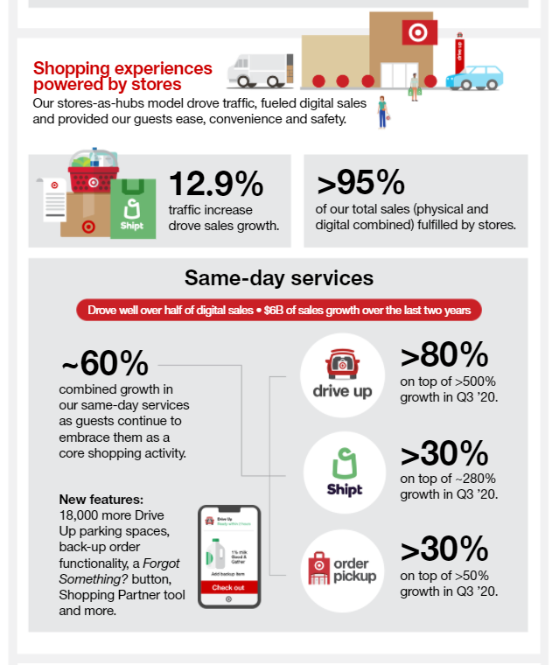
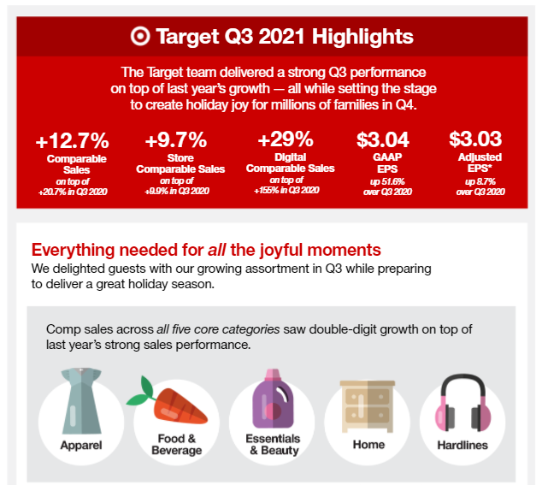
Target spotlight: same-day services up +60%, lapping +200% YA growth
Source: Target Q3 2021 (November 17, 2021) Quarterly Earnings Report – Target Corporate

Slide 17

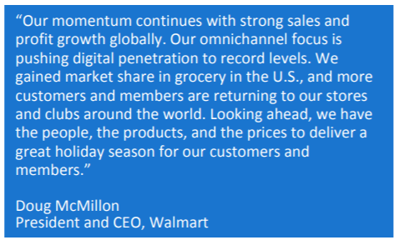
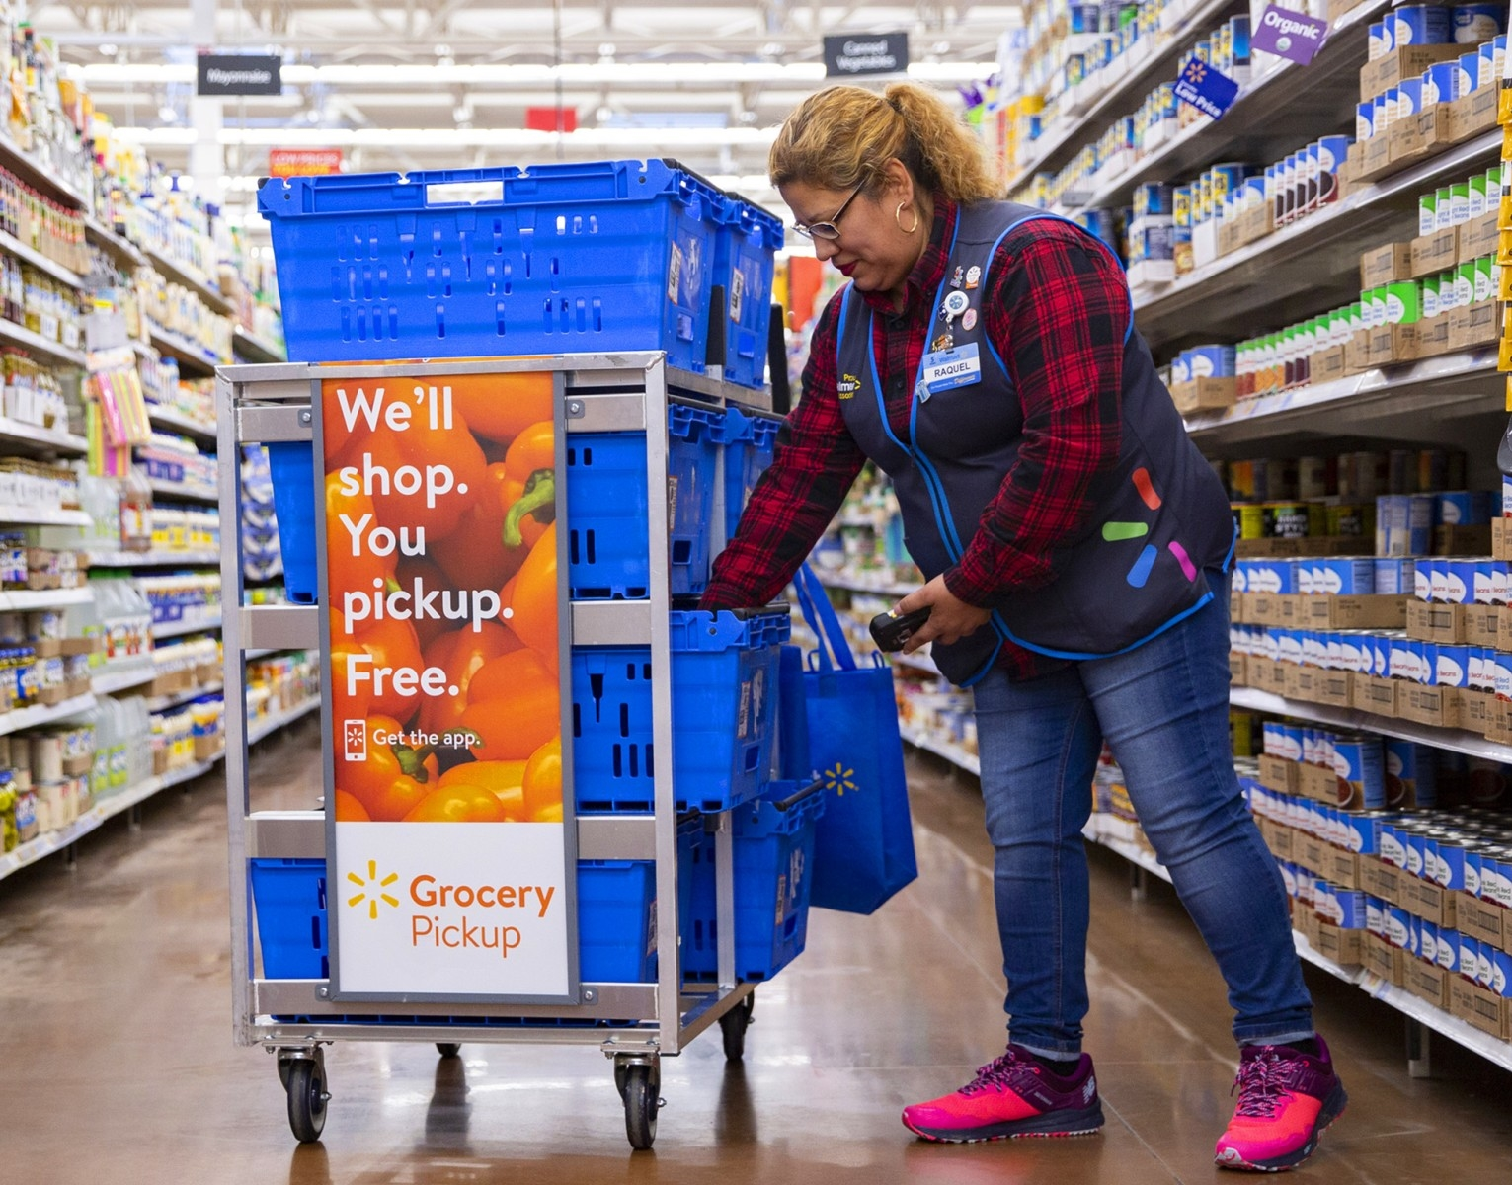
Walmart spotlight: traffic continues to rebound; omnichannel focus in US pushing digital penetration to “record levels”
$96.6B
Q3 FY22
+9.2%
Comp sales
+8.0%
eCommerce sales
+5.7%
Comp transactions
Source: Walmart Q3 2021 (November 16, 2021) Quarterly Earnings Report – Walmart Corporate

Slide 18
COVID Segmentation Impact

Slide 19
Although all groups made more J&J trips, Existing Constrained & Cautious Insulated shoppers contributed the most to J&J’s Q4 trip growth
Similar trends for Total Category Set; all groups grew their spend per trip vs YA
Total J&J
Total J&J Category Set
 | Trips (M) | Trips % Chg | $ Per Trip | $ Per Trip % Chg | Trips (M) | Trips % Chg | $ Per Trip | $ Per Trip % Chg
Existing Constrained | 25.3 | +9.0% | $9.74 | +1.5% | 250.1 | +4.2% | $11.23 | +8.9%
Newly Constrained | 31.0 | +0.2% | $10.08 | +4.2% | 287.8 | -0.5% | $11.67 | +5.8%
Cautious Insulated | 47.4 | +9.3% | $10.11 | +5.5% | 419.5 | +4.3% | $11.97 | +6.1%
Unrestricted Insulated | 43.4 | +5.8% | $9.91 | +1.2% | 397.9 | +2.4% | $11.59 | +4.5%
Source: Nielsen Homescan Trip Projection, Global Economic Segmentation; Total US, L13 WE 1-1-22 vs YAGO

Slide 20




Retailer preferences continue to vary by COVID Segment; highest indices among Dollar, Drug, and Food
Index to Total Panel – J&J Trips
 | Existing Constrained | Newly Constrained | Cautious Insulated | Unrestricted Insulated
 | 110 | 101 | 98 | 95
Total Food | 85 | 89 | 94 | 122
 | 99 | 91 | 115 | 90
 | 89 | 112 | 122 | 74
 | 94 | 120 | 103 | 86
Total Online | 110 | 108 | 89 | 100
Total Dollar | 135 | 116 | 87 | 83
Total Club | 107 | 81 | 99 | 110
Retailers ranked by number of J&J Trips for Total Panelists
Source: Nielsen Homescan Trip Projection, Global Economic Segmentation; Total J&J, L13 WE 1-1-22, index calculation: COVID group share of trips/Total Panel share of trips*100

Slide 21
Constrained and Cautious Insulated shoppers are making more J&J trips to Drug, contributed to overall J&J trip growth at these retailers
Online J&J trip declines are driven by Constrained and Cautious Insulated shoppers, where Club declines are driven by Insulated shoppers
J&J Trips % Chg – L13 WE 1-1-22 vs YA
 | Total Panel | Existing Constrained | Newly Constrained | Cautious Insulated | Unrestricted Insulated
 | +23.7% | +41.1% | +49.5% | +31.1% | +21.0%
 | +17.2% | +40.1% | +26.6% | +30.5% | -13.1%
Total Food | +8.8% | -1.6% | +1.9% | +16.4% | +17.1%
 | +8.5% | +74.3% | -6.8% | +17.9% | -5.1%
Total Dollar | +6.7% | -10.2% | -23.9% | -47.0% | +10.1%
 | +6.5% | +8.3% | -2.3% | +16.5% | +3.5%
Total Online | -1.4% | -4.6% | -18.8% | -15.3% | +0.9%
Total Club | -2.9% | +17.0% | +7.2% | -2.8% | -11.5%
Source: Nielsen Homescan Trip Projection, Global Economic Segmentation; Total J&J

Slide 22
Key Insights on J&J Trips

Slide 23


Key insights on Q4 2021 J&J consumer shopping trips
TOTAL TRIPS
Total US J&J trips are up +7.3% vs YA in the L13 WE 1-1-22, outpacing that of Total Category; J&J Self Care driving trip growth. J&J trip growth was greatest in Drug; growing trips in all major channels and retailers aside from Total Online and Club. J&J grew trips among most race/ethnicity and HHI cohorts.
CLICK & COLLECT EFFECT
J&J Q4 21 Click & Collect trips are down slightly (-2.6% vs YA), lapping YA growth. Total Store and Total Category Set C&C trips did however grow in the L13 weeks, with Target seeing another strong Quarter. Shoppers continue to spend more per C&C trip than in Brick & Mortar across J&J.
COVID SEGMENTATION
Existing Constrained & Cautious Insulated shoppers contributed the most to J&J’s overall trip growth in Q4 21 vs YA, with similar trends for Total Category Set. Constrained & Cautious Insulated shoppers are making more J&J trips to Drug, contributing to overall J&J trip growth at these retailers.

Slide 24
2021 Year in Review

Slide 25
Self Care + Sun Care were the biggest trip drivers in 2021; Total J&J trip growth outpaced that of Total Category for the year
J&J Trips % Change vs YAGO – Total US
+23M
J&J Trips in FY 21
Total Category Trips % Chg. | +0.8% | +3.2% | +18.8% | +0.2% | -0.9% | -9.1% | +0.7% | +2.9% | +1.1% | -9.3%
J&J outpacing Total Category
Source: Nielsen Homescan Panel Trip Projection, Total US, L52 WE 1-1-22 vs YAGO

Slide 26
Drug, Mass, and Dollar drove overall J&J trip growth in 2021
Drug retailers, Dollar, and Walmart all outpaced Total Category Set trip growth; J&J and Total Category spend per trip grew for the year across all major retailers and channels
Total J&J
Total Category Set
 | Trips % Chg | $ per Trip | $ per Trip % Chg | Trips % Chg | $ per Trip | $ per Trip % Chg
Total US | +3.7% | $65.08 | +4.6% | +0.8% | $502.59 | +5.5%
 | +12.8% | $37.01 | +3.4% | +7.0% | $117.18 | +7.3%
 | +7.4% | $31.35 | -2.7% | +12.8% | $126.74 | +13.5%
Total Dollar | +6.6% | $18.62 | +11.0% | -6.7% | $56.31 | +1.9%
 | +6.4% | $35.99 | +10.5% | +2.0% | $107.59 | +9.3%
 | +5.8% | $31.22 | +6.8% | +2.1% | $166.18 | +7.3%
Total Online | +4.5% | $39.98 | +3.7% | +12.1% | $154.75 | +7.8%
Total Food | -0.5% | $30.26 | +6.3% | -2.2% | $124.69 | +2.6%
Total Club | -4.2% | $31.95 | +2.6% | +0.4% | $114.38 | +2.4%
Aside from Total Online, Retailers are primarily defined as B&M in Panel
Source: Nielsen Homescan Panel Trip Projection, L52 WE 1-1-22 vs YAGO

Slide 27
African American and White households drove J&J trips in 2021, along with both the highest and lowest income households
J&J Trips % Chg by Race/Ethnicity
J&J Trips % Chg by HH Income
Source: Nielsen Homescan Panel Trip Projection, Total J&J, Total US, L52 WE 1-1-22 vs YAGO

Slide 28
J&J Click & Collect FY 21 trip growth driven by shoppers making more trips, spending more overall & per trip; growth lapping +214% YA growth
J&J C&C Trips
J&J C&C Trip % Chg vs YA
J&J DIGESTIVE HEALTH | +54.1%
J&J UPPER RESPIRATORY | +27.8%
J&J COMPROMISED SKIN | +20.2%
J&J SUN CARE | +18.9%
J&J ANALGESICS | +18.8%
J&J HAND & BODY | +8.1%
J&J ORAL CARE | +2.9%
J&J FACIAL CARE | +0.9%
J&J BABY & CHILD CARE | -5.9%
33.0M
+7.1%
J&J Category Set C&C Trips up +18.3%
in FY 21 vs YA
J&J C&C $ Sales
J&J C&C $ per Trip
$420M
+8.4%
$12.73
+1.2%
Source: Nielsen Homescan Panel Trip Projection, Total J&J Category Set, Target, Click & Collect = Local Delivery + Drive-Thru + In-store, L52 WE 1-1-22 vs YAGO

Slide 29
Newly Constrained & Cautious Insulated shoppers contributed the most to J&J’s overall 2021 trip growth
Similar trends for Total Category Set; all groups grew their spend per trip vs YA
Total J&J
Total J&J Category Set
 | Trips (M) | Trips % Chg | $ Per Trip | $ Per Trip % Chg | Trips (B) | Trips % Chg | $ Per Trip | $ Per Trip % Chg
Existing Constrained | 107.7 | -4.2% | $9.81 | +4.4% | 1.0 | -8.1% | $11.07 | +9.7%
Newly Constrained | 133.4 | +11.9% | $9.96 | +1.0% | 1.2 | +8.1% | $11.42 | +5.7%
Cautious Insulated | 198.6 | +8.1% | $10.08 | +2.9% | 1.7 | +1.4% | $11.71 | +5.7%
Unrestricted Insulated | 177.1 | -1.5% | $9.82 | +1.7% | 1.6 | -3.6% | $11.55 | +5.0%
Source: Nielsen Homescan Trip Projection, Global Economic Segmentation; Total US, L52 WE 1-1-22 vs YAGO

Slide 30
2021 Key Takeaways
Overall J&J trips in 2021 were up +3.7%, outpacing Total Category Set at +0.8%
J&J Trips were greatest in Q2 and Q3 21, following widespread COVID vaccination availability, along with lower COVID case numbers throughout the country; lapping 2020 lockdown periods
Self Care + Sun Care were the biggest trip drivers in 2021; Total J&J trip growth outpaced that of Total Category
Drug, Mass, and Dollar drove overall J&J trip growth in 2021, with J&J trips to Drug, Dollar, and Walmart all outpacing Total Category Set trip growth; J&J and Total Category spend per trip grew for the year across all major retailers and channels
J&J Click & Collect FY 21 trips were up +7.1%, lapping +214% YA growth; current year C&C trip growth was driven by shoppers making more J&J trips, spending more overall & per trip
Newly Constrained & Cautious Insulated shoppers contributed the most to J&J’s overall 2021 trip growth, with similar trends for Total Category Set; all groups grew their spend per trip vs YA across J&J and Total Category

Slide 31
Appendix

Slide 32
Shoppers made more trips for the Total Category Set in Q4 21 vs YA, overall trips have remained steady since Q2
Total J&J Category Set Trips – Total US
Trips % Chg.
vs. YAGO
J&J Cat Set | 1.9% | 9.4% | -1.3% | -1.3% | -2.8% | -9.8% | 5.0% | 5.0% | +3.7%
J&J | 2.5% | 12.7% | -1.3% | -0.1% | -1.7% | -11.9% | 9.4% | 10.7% | +7.3%
Source: Nielsen Homescan Panel Trip Projection, Total J&J, Total US, L13 WE 1-1-22 vs YAGO

Slide 33








Click & Collect models available in Nielsen
Reported by 75% of Nielsen Homescan Panelists
ONLINE PURCHASE & SAME DAY LOCAL DELIVERY
Order online from a local store and retailer delivers products to home
within hours
ONLINE PURCHASE & DRIVE THRU/CURBSIDE PICKUP
Order online from a local store and collect your purchases without leaving your car
ONLINE PURCHASE & IN-STORE PICKUP
Order online from a local store and pick up your order inside the selected store location
For this presentation:
Click & Collect = sum of all three models above

Slide 34
Four unique consumer groups emerged in 2020 and will continue to shaping consumption patterns in 2021 and beyond
These consumers are altering their buying and
consumption patterns
Existing constrained
Newly constrained
Cautious insulated
Unrestricted insulated
Were financially insecure before COVID. They continue to struggle but are less emotionally and socially impacted by COVID.
Pragmatic
Didn’t change routine too much
They are not stocking up
COVID had significant impacts on their financial and social situation. They are anxious about the future and are watching their spending.
Stressed out
Stocking up
Joblessness
Insecure about the future
Concerns about health are the drivers behind their change in behavior. Still financially secure, but planning for an uncertain future..
Discovering the joy at home
More time for beauty, hobbies, and leisure
Are far less concerned about COVID, haven’t had to modify their spending habits. Their financial security affords them more emotional stability.
Wants life back
Say that behavior and habits didn’t change and will not change

