Slide 1
Is product content really the fountain to success?

Slide 2




The statistics say it all...
67%
of shoppers do not choose an item if no image is available
The future is built on accurate data.
Gain instant access and leverage the most complete and accurate FMCG product database today.
NielsenIQ Brandbank is the leading provider of digital product content solutions powering omnichannel shopping experiences. Our digital product database comprises comprehensive, standardised and complete on pack product imagery and data.
90%
of online shoppers say that photo quality is the most important factor in an online sale
78%
of online shoppers want photographers to bring products to life as they want to see the product as if it is part of their own daily lives
42%
of shoppers would prefer additional content on product pages to support their purchasing decision

Slide 3
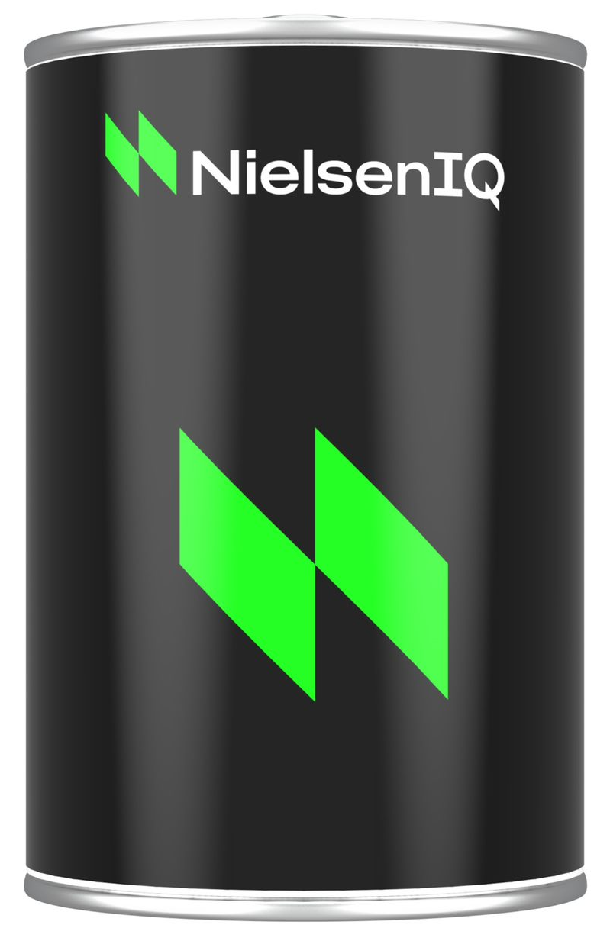
Your journey to power digital growth
Content is king, and shoppers demand and expect quality product content as they progress along their purchase path.
The future of commerce is putting rich, authentic and trusted content into the hands of shoppers. Shoppers expected robust digital product content across all channels.
Those that can provide unique and relevant product content at key touchpoints are the ones that will win shopper trust and come out on top.
Access accurate and up to date brand approved digital product content on 50+ million FMCG products direct from NielsenIQ Brandbank's Product Library or API.
Manufacturer details
Packaging information
Nutritional information
Product description
Ingredients
Allergens
Weight and dimensions
Storage information
Preparation instructions
Primary image for product

Slide 4
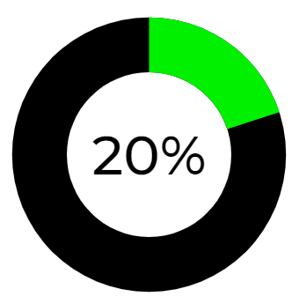

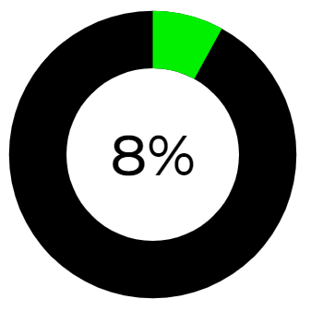
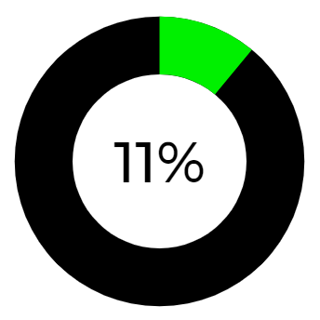
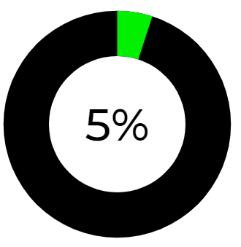
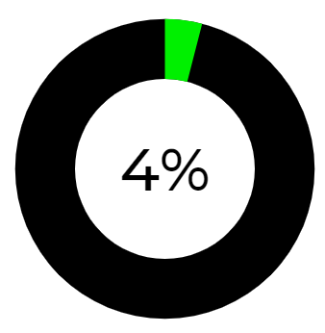
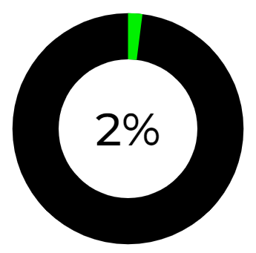
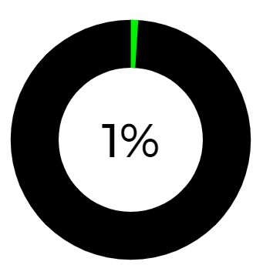
Go beyond the back of pack
Low fat
Sugar conscious
Low sodium
Low carbohydrate
Shoppers are becoming more aware of what they are consuming, 2 out of every 3 shoppers want to exclude food from their diet. Whether this be for dietary, lifestyle or health requirements.
Dramatic changes in shopper purchase behaviour related to ecommerce and health and wellness preferences have created the need for a new approach to product data.
To meet the demands of today’s digital-first shoppers, product attribute metadata has emerged as a “must-have’’ complement to legacy data sources for FMCG brands and retailers looking to differentiate to win omnichannel market share and build lasting loyalty.
If you want to drive better product discovery, you must be prepared to invest more attention in going beyond the pack.
Vegetarian
Flexitarian
Halal
Wheat or gluten free
Lactose/dairy free
Vegan
Kosher
What is shopper metadata?​
Shopper metadata is pieces of information that have some meaning in relation to another piece of information.​

Slide 5
Activate your channel specific needs
The “why behind the buy” - the primary decision-making criteria that drives shopper purchase include understanding the product itself. This has added an entirely new layer of complexity to how product makers provide information to shoppers, package and market their products.
Sustainability
Search and filter
Shoppers demand product transparency to identify healthy, socially and environmentally friendly products that meet their desired needs and enable them to make an informed purchasing decision.
Shoppers identify speed and convenience as their top priority for online grocery shopping. Shoppers want to employ search bars and filter options to refine search results based on more granular classification.
Health and wellness
Master data management
Shoppers expect personalisation to help identify the products that are suitable for their lifestyle and taste preferences without having to click through to product pages.
Shoppers want the most extensive and structured set of attributes across all products to drive purchasing decisions. Win the omnichannel battle by leveraging the most comprehensive collection of worldwide FMCG product data available today.

Slide 6
What's next?
Join world leading brands and gain instant access to FMCG product content. Contact the NielsenIQ Brandbank team on content.sales@smb.nielseniq.com
Digitalise the shopper experience with

