Slide 1

A Roundtable on What Matters to Customers
Climate, carbon,
and consumer insights:
© 2021 Nielsen Consumer LLC. All Rights Reserved.

Slide 2
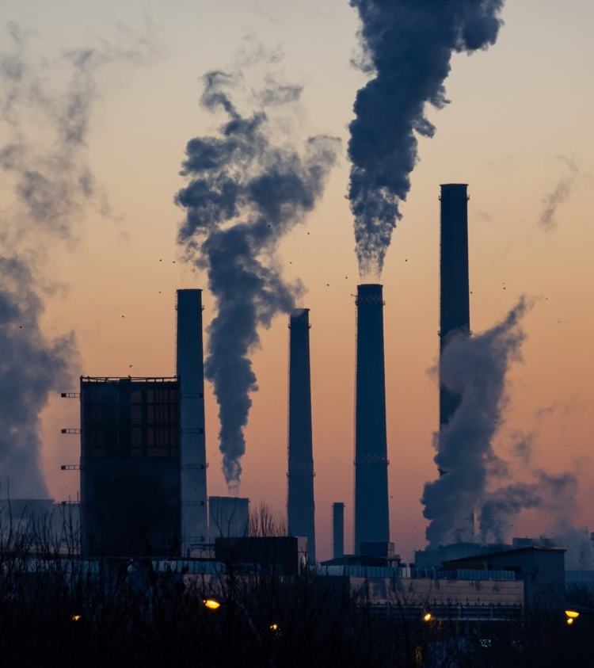
Changes will shape and guide
consumer choice
78%
say a sustainable lifestyle is important to them
61%
agree environmental issues are having an adverse impact on their current and future health.
30%
are more likely to buy products with sustainable credentials
2
Source: NielsenIQ Global Health & Wellness Study of 17 markets, September 2021, US results; NielsenIQ Omnibus Survey, Dec 2021
Notes:
Consumers recognize their world is changing and health needs are increasing important…whether it’s the increased importance of universal healthcare, or the added concerns that environmental issues are affecting our health. There have been some positive impacts of the pandemic…as more consumers found it easier to be healthy when they’re spending time at home.
Working from home made it easier to eat healthfully and showed us the impact on the planet (when we stopped commuting, the earth started to repair itself).

Slide 3
Consumers’ health and wellness needs have evolved beyond the basics of physical wellbeing
NielsenIQ hierarchy of total health & wellness needs
Urgent care
Protecting myself and/or my family members from immediate health threats.
Protective
Self care
Improving my and/or my family's current physical or emotional wellbeing and connections.
Preservation
Preventative care
Proactive actions to achieve & maintain specific health goals, or helping to avoid ailments in the long-term.
Aspirational
Innovative care
Seeking out the latest alternatives or developments to continuously meet my and/or my family's health & wellness goals.
Evolving
Selfless care
Improving the world around me by advocating for environmental, ethical, humanitarian, and/or philanthropic causes.
Altruistic

Slide 4
Climate change tops consumer concerns
Which are you most concerned about?
NielsenIQ Omnibus Survey, Dec 2021, Q1. Which of these topics are you personally most concerned about? Please select all that apply? Q2. Overall speaking, how important is a sustainable lifestyle to you?
Notes:
Q1. Which of these topics are you personally most concerned about? Please select all that apply.
Q2. Sustainability means meeting our current needs without compromising the ability of future generations to meet their own needs.It includes natural resources, economic resources and social resources.Overall speaking, how important is a sustainable lifestyle to you?

Slide 5





Focus on attributes that matter most to consumers now
More like to buy: Purchase preference change over the last 2 years (More – less likely to buy)
Health & hygiene |  | Social and sustainable |  | Cost and quality |  | Convenience and time saving |  | Origin and experience
Fresh produce | +26 | Supported consumers during COVID | +22 | Affordable/lower prices | +32 | Makes working at home easier | +14 | Known & trusted | +24
Nutritional benefits | +18 | Environmental/ Sustainable | +17 | Private Label/ Store Brands | +16 | Makes household chores easier | +13 | From my local neighbourhood | +17
Hygiene/safety claims | +17 | Socially responsible | +16 | Guarantees - safety/quality | +11
Healthier options | +17 | Ingredient/supply chain transparency | +14
Source: NielsenIQ 2022 Consumer Outlook Survey, Dec 2021, US
Q. How have your brand and product purchasing preferences changed over the last 2 years (since COVID-19)?
Notes:
These changes in priorities will flow into the decision they make on the products and services they will buy and use and the companies that want to support.
Each of these variables play an important role in how consumers want to shape their lives moving forward
Affordability is critical which comes as no surprise when we consider the circumstances so many consumers have faced over the last 2 years
Fresh produce healthier alternatives and enhanced nutrition enable consumers to be more proactive when it comes to taking charge of their physical wellbeing with a fundamental need for hygiene and safety in all aspects moving forward.
Understanding that the role we play in the world is much bigger than ourselves – seeking out sustainable options; looking out for more vulnerable members of society and ensuring companies are transparent in their supply chains and authentic in what they stand for.
Local origin has become increasingly important – both as a security against availability issues but also to support local economies and protect communities.
Ongoing @ home lifestyles means consumers seek alternatives that make it easier for them to balance work and life priorities.

Slide 6






Across 90+ attributes illustrate care for environment, others and animals all important
$ Volume
Total Store Chg. vs 2YA
+6.8%
Social Responsibility
+11.4%
Sustainable Farming
+13.3%
Environmental Sustainability
+1.1%
Sustainable Forestry
+10.4%
Sustainable Packaging
+21.0%
Animal Welfare
+27.3% B Corporation
+18.9% Fair Trade +18.2% Ethical +2.6% Fair Wages
+37.9% EU Organic Farming
+22.0% Farm Raised +14.2% Family Farmed
+59.7% Carbon Free +56.7% Renewable Resource +55.3% Reef Safe +35.5% Renewable Energy +33.1% Less Emissions
+18.2% Contains Sustainable Palm Oil
+20.7% Sustainable Forestry Initiative +7.9% Forest Stewardship Council
+83.6% Plastic Free +75.6% Renewable Pkg Cntnt +23.4% Terracycle +20.0% Tetra Pak +15.0% Free from BPA
+46.2% Cruelty Free
+30.7% Marine Stwdshp Cncl +23.0% Free Range +21.4% Humane +20.4% Cage Free
Claims/Certifications that are stated on package
Source: NielsenIQ Retail Measurement Services, NielsenIQ Product Insight,, powered by Label Insight, Total Store; Total US xAOC; Latest 52 weeks W/E 03/26/22 vs 2YA

Slide 7
Consumers are demonstrating more interest in sustainability in Food & Beverage categories
$ % Chg. vs 2YA – Total Store
Department | Social responsibility |  | Sustainable farming |  | Environmental sustainability |  | Sustainable packaging |  | Animal welfare
 | Growth | Shr | Growth | Shr | Growth | Shr | Growth | Shr | Growth | Shr
Total Store | +6.8% | 2% | +11.4% | <1% | +13.3% | 25% | +10.4% | 5% | +21.0% | 3%
Total Food & Beverage | +22.4% | 2% | +12.7% | <1% | +16.8% | 26% | +12.8% | 5% | +18.9% | 3%
BevAl | +15.5% | 3% | -2.2% | <1% | +1.8% | 39% | +9.5% | 5% | +8.2% | >1%
Vitamins/OTC | +44.2% | 2% | +14.1% | <1% | +15.8% | 15% | +3.4% | 1% | +15.9% | 2%
Beauty/Personal Care | +14.4% | 2% | -71.1% | <1% | +16.0% | 19% | +11.9% | 6% | +33.7% | 18%
Household Care | -30.5% | 5% | +42.4% | <1% | +4.3% | 58% | +4.7% | 19% | +6.9% | 2%
Pet Care | -27.0% | <1% | +90.9%¹ | <1% | +6.9% | 14% | +49.9% | 1% | +3.0% | 1%
Source: NielsenIQ Retail Measurement Services, NielsenIQ Product Insight,, powered by Label Insight, Total Store; Total US xAOC; Latest 52 weeks W/E 03/26/22 vs 2YA
1 = Sustainable farming in Pet Care = low volume
Notes:
Grab super categories for reference
Note: In our NielsenIQ Product Insight, launched this year with our acquisition of Label Insight, we track more than 80+ attributes (up to 93 in some categories) around sustainability, in the buckets of social responsibility, sustainable farming, sustainable resource management, sustainable forestry, sustainable packaging and animal welfare.
At NielsenIQ, we see the conversation transitioning from sustainability (which is about minimizing impact) to regeneration (how do we leave the earth better/rebuild the damage that has been done). And beyond just our planet, the conversation is about humanity…how do we care for each other (social responsibility/social equity and justice) and how do we care for all living things (animal welfare). Growth of these trends outpacing growth of store. (Note: only the bottom line is 2YA, all other trends on slide are YA.)

Slide 8

Consumers want companies to take action
Reduce the amount of plastic in packaging | 53%
Be efficient, eliminate material waste | 51%
Use sustainable packaging materials | 46%
Reduce production waste, reintroducing it into manufacturing cycle | 44%
Reduce the packaging of products | 44%
Reduce the amount of CO2 emitted | 37%
Reduce the amount of energy used in the production process | 33%
Reduce the amount of water used in the production cycle | 30%
Only use sustainable suppliers | 22%
Reduce transport required for raw materials/ end product distribution | 22%
Only use locally sourced materials/ingredients | 21%
Produce close to the markets where products are sold | 20%
Don’t know/Not sure | 19%
Only use local suppliers | 18%
Be active in charitable engagements | 16%
Other | 1%
To be called sustainable, which of the following actions should companies take?
NielsenIQ Omnibus Survey, Dec 2021, Q4. To be called sustainable, which of the following actions should companies take? Please select all that apply.

Slide 9
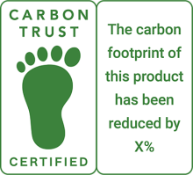
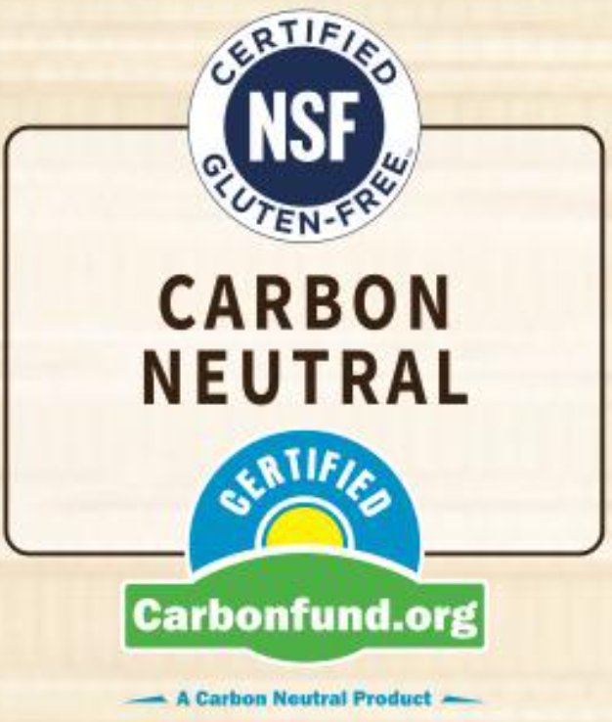



Top performing categories for Carbon claims
+5%
Carbon Zero
+5%
Carbon Footprint
+15%
Carbon Neutral
+60%
Carbon Free
-50%
Carbon Ftprnt Stndrd
DY – Eggs
HB – Hair care
FZ – Fruit
GR – Beverages
HB – Bath & Shower
DY – Eggs
FZ – Fruit
HB – Hair Care
HB – Bath & Shower
DY – Beverages
HB – Sexual Health
GR – Beverages
HB – Vitamins & Supps
GR – Sugar & Swtnrs
GR – Beverages
GR – Packaged Tea
GR – Cookies / Crackers
GR – Oils / Butter / Margarine Spreads / Substitutes
DL = Deli, DY = Dairy, FZ = Frozen, GR = Grocery, HB = Health & Beauty Care
Source: NielsenIQ Retail Measurement Services, NielsenIQ Product Insight,, powered by Label Insight, Total Store; Total US xAOC; Latest 52 weeks W/E 03/26/22 vs 2YA

Slide 10
Sustainable packaging is an area of opportunity across store
Recyclable is becoming baseline
 |  |  | $ % C2YA | $ Volume
 |  | Total Store | +14%
 | % of All Plant Based Protein | Sustainable Packaging | +13% | $51.6B
Proven trends |  | Recyclable** | +17% | $269.2B
 |  | Recycled Packaging | +8% | $36.2B
 |  | Recycled Packaging Content | +8% | $26.8B
Growing trends |  | 100% recycled paperboard | +8% | $15.2B
 |  | Biodegradable | +5% | $7.5B
 |  | Terracycle | +25% | $7.1B
Developing trends |  | Tetra pak certified | +22% | $1.9B
 |  | Renewable Packaging Content | +78% | $295.4M
 |  | Plastic-Free | +96% | $185.4M
Packaging search trends*
+ 94%
Plastic free
Personal Care
+74%
Refillable Packaging Personal Care
-11%
Disposable
Personal Care
‘Stated‘ claims on package
Source: NielsenIQ Retail Measurement Services, NielsenIQ Product Insight, powered by Label Insight, Total Store; Total US xAOC; Year end 2021 - 52 weeks W/E 01/01/22 vs 2YA
*Label Insight search data, annual searches, from Amazon, Shipt, Target, Walmart, Kroger
**Recyclable is not included in the “Sustainable Packaging” total attribute
Notes:
.

Slide 11

U.S. consumers reach consensus on the meaning of altruism
Micro-culture Maturity Curve Health & Wellness in the context of “Altruism”
Microculture | Key Topics | Maturity
Aging with dignity | Senior care, small acts of service, community care | 50.6%
Mental health advocacy | Mental wellbeing, de-stigmatizing, stressors | 44.4%
Social bonds | Social health, interaction for health benefits | 41.2%
Healthy eating for all | Nutritional diet, better eating for health of community | 37.0%
Sustainable wellness | Sustainable lifestyle, support environment and own sense of wellness | 33.9%
53.5%
43.3%
predicted
current
New
ideas
Early
consensus
Mainstream
acceptance
Established
ideas
Source: MotivBase, a NielsenIQ Connected Partner

