Slide 1
GERMANY ON PREMISE CONSUMER PULSE REPORT
CGA by NIQ, June 2024

Slide 2
SUMMARY: TOPLINE VISITATION & INTENTION
Despite a general decline in On Premise visitations, drink led outings have seen a 2% increase compared to May. With 77% of consumer planning on increasing or maintaining their visitation frequency the coming month.
Driving increased visitation is seasonality (+3pp vs May), consumer wanting to support local businesses (+12pp vs May) as well trialling new venues (+5pp vs May).
Beer consumption has seen an increase in June whilst spirits, neat or as a cocktail, have seen a decline: likely as a result of the increase marketing around the Euros
The rate and spend of delivery ordered has seen a slight decrease with less consumers ordering compared to last month.
Signature cocktails haven’t reached their full potential yet with only 25% of consumer having tried them already, whilst 1 in 2 consumer would be willing to try them. Venues should leverage the exclusivity factor to commercialise on the appeal of signature cocktails and satisfy consumer interest.
As summer is drawing people outdoors, Beer gardens (44%) and Street fairs are among the most typical venues visited. With beer, cocktails and non-alcoholic options being the most consumed.
Ahead of a great sporting summer, Public viewing spots to watch sports are seeing a popularity surge and present a prime opportunity for brand activations.

Slide 3
CGA’S MONTHLY CONSUMER PULSE
This monthly On-Premise Consumer Pulse report is intended to capture consumers consumption patterns and how they fluctuate in the transition period from April 2024 to May 2024 in Germany.
This study looks into consumer’s On-Premise behaviour over the past month and tests visit intention for the month ahead. ​
In other countries, this monthly check-in has become a staple for beverage suppliers and other businesses interested in the channel. ​
These monthly updates will help interested parties to stay close to the consumer’s intentions and behaviours for our beloved On Premise channel. ​
For this June 2024 issue, we surveyed 1000 consumers (aged 18+) between the 23rd – 28th June 2024. These consumers were situated across all German regions and must typically visit On Premise venues at least once within a 3-month period. ​
This report touches upon hot topics including Signature Cocktails as well as outdoor activites.

Slide 4
KEY METRICS / ON PREMISE
VISITATION​ ​

Slide 5
LOOKING BACK
VISITATION IN THE ON PREMISE OVER THE PAST MONTH
96 % visited the On Premise this month.
-1pp vs May
SOURCE: CGA MONTHLY ON PREMISE CONSUMER PULSE REPORT JUNE 2024 – SAMPLE: 1000

Slide 6
LOOKING AHEAD
VISITATION PLANS FOR THE ON PREMISE MONTH AHEAD
87%
Plan to go out to eat in the next month
+2pp vs May
55%
Plan to go out to drink in the next month
+1pp vs May
4% don’t plan to visit the on premise next month
-1pp vs May
SOURCE: CGA MONTHLY ON PREMISE CONSUMER PULSE REPORT MAY 2024 – SAMPLE: 1003 - 1000

Slide 7
HOW DOES YOUR CURRENT BEHAVIOUR COMPARE TO HOW FREQUENTLY YOU USUALLY GO OUT?
Change in frequency of visitation
19%
Going out more often
49%
Going out the same
33%
Going out less often
=0pp vs May
=0pp vs May
=0pp vs May
SOURCE: CGA MONTHLY ON PREMISE CONSUMER PULSE REPORT MAY 2024 – SAMPLE: 1003-1000

Slide 8
ON WHICH DAY(S) OF THE WEEK HAVE YOU VISITED A BAR, RESTAURANT OR OTHER SIMILAR VENUE OVER THE PAST MONTH?
-1pp
+3pp
SOURCE: CGA MONTHLY ON PREMISE CONSUMER PULSE REPORT JUNE 2024 – SAMPLE: 944 - 959

Slide 9
HOW OFTEN HAVE YOU VISITED BARS, RESTAURANTS AND OTHER SIMILAR VENUES OVER THE PAST MONTH?
=0pp
+3pp
-3pp
=0pp
SOURCE: CGA MONTHLY ON PREMISE CONSUMER PULSE REPORT JUNE 2024 – SAMPLE: 944, 959

Slide 10
Those visiting the on premise more frequently than usual are typically younger, more likely to be located within the city / town centre and with a higher average household income than those who are visiting less often
Going out more | Going out less
Age groups
Gender
54% 45%
46% 55%
Location of residence
Typically visits the On Premise…
63% 41%
Average household income
65% 14%
At least weekly
€48,353 €40,301
City centre / town centre
94% 64%
37% 59%
At least monthly
Rural / suburban
SOURCE: CGA MONTHLY ON PREMISE CONSUMER PULSE REPORT JUNE 2024 – SAMPLE: 185, 327

Slide 11
34%
43%
Of Gen Z are going out more often this month
+24pp vs average consumer
Of Gen Z are spending more overall on eating and drinking out this month
+4pp vs average consumer
SOURCE: CGA MONTHLY ON PREMISE CONSUMER PULSE REPORT JUNE 2024 – SAMPLE: 154, 294

Slide 12
YOU HAVE SAID THAT YOU ARE CURRENTLY GOING OUT MORE FREQUENTLY THAN USUAL, WHY IS THIS?
SOURCE: CGA MONTHLY ON PREMISE CONSUMER PULSE REPORT MAY 2024 – SAMPLE: 185-188

Slide 13
YOU SAID THAT YOU ARE CURRENTLY GOING OUT LESS FREQUENTLY THAN USUAL, WHY IS THIS?
+2pp
=0pp
-2pp
=0pp
-1pp
SOURCE: CGA MONTHLY ON PREMISE CONSUMER PULSE REPORT JUNE 2024 – SAMPLE: 327

Slide 14
HAVE YOU CHANGED YOUR BEHAVIOUR IN ANY OF THE FOLLOWING WAYS OVER THE PAST MONTH, COMPARED TO USUAL, IN BARS, RESTAURANTS AND SIMILAR VENUES?
NET Change
+7pp
+9pp
SOURCE: CGA MONTHLY ON PREMISE CONSUMER PULSE REPORT JUNE 2024 – SAMPLE: 1000

Slide 15
WHICH IF ANY OF THE FOLLOWING ARE REASONS WHY YOU ARE SPENDING MORE NOW WHEN OUT PER VISIT IN BARS, RESTAURANTS AND SIMILAR VENUES?
+2pp
-1pp
+2pp
=0pp
+1pp
+3pp
+1pp
-1pp
-1pp
SOURCE: CGA MONTHLY ON PREMISE CONSUMER PULSE REPORT MAY 2024 – SAMPLE: 214, 299

Slide 16
WHICH IF ANY OF THE FOLLOWING ARE REASONS WHY YOU ARE SPENDING LESS NOW WHEN OUT PER VISIT IN BARS, RESTAURANTS AND OTHER SIMILAR VENUES?
-6pp
-7pp
+4pp
-3pp
+2pp
+1pp
+3pp
SOURCE: CGA MONTHLY ON PREMISE CONSUMER PULSE REPORT JUNE 2024 – SAMPLE: 201, 206

Slide 17
WHICH OF THE FOLLOWING HAVE YOU HAD IN BARS, RESTAURANTS AND SIMILAR VENUES IN THE PAST MONTH?
+1pp
+1pp
SOURCE: CGA MONTHLY ON PREMISE CONSUMER PULSE REPORT JUNE 2024 – SAMPLE: 944, 959

Slide 18
HOW OFTEN DO YOU PLAN TO VISIT BARS, RESTAURANTS OR OTHER SIMILAR VENUES OVER THE NEXT MONTH?
+21pp for Gen Z
SOURCE: CGA MONTHLY ON PREMISE CONSUMER PULSE REPORT JUNE 2024 – SAMPLE: 153 - 999

Slide 19
Tracking delivery consumption

Slide 20
53%
Of Consumers have ordered delivery in the past month
-1pp vs May
24% Have not ordered delivery this month
23% Never order delivery
SOURCE: CGA MONTHLY ON PREMISE CONSUMER PULSE REPORT JUNE 2024 – SAMPLE: 1000, 1003

Slide 21
HOW OFTEN HAVE YOU ORDERED DELIVERY / TAKE AWAY IN THE PAST MONTH? (EX. DELIVEROO, UBER EATS)
0pp
+21pp for Gen Z
-1pp
+2pp
-2pp
0pp
SOURCE: CGA MONTHLY ON PREMISE CONSUMER PULSE REPORT JUNE 2024 – SAMPLE: 154 - 1003

Slide 22
YOU HAVE SAID YOU HAVE ORDERED DELIVERY IN THE PAST MONTH, HOW MUCH DO YOU USUALLY SPEND ON DELIVERY EVERY MONTH?
55€
Average Spend on delivery a month for all consumers
 | Consumers aged 18-34 | Consumers aged 35-54 | Consumers aged Ages: 55+
Average Spend on delivery a month | 69€ | 49€ | 40€
SOURCE: CGA MONTHLY ON PREMISE CONSUMER PULSE REPORT JUNE2024 – SAMPLE: 118 - 532

Slide 23
Hot topic: Signature Cocktails

Slide 24
HAVE YOU TRIED ANY SIGNATURE COCKTAILS?​
50%
Have not tried but would be interested in trying them
25%
Have not tried and would not be interested in trying them
25%
Have tried
SOURCE: CGA MONTHLY ON PREMISE CONSUMER PULSE REPORT JUNE 2024 – SAMPLE: 1000

Slide 25
WHAT ARE YOUR EXPECTATIONS FOR A SIGNATURE COCKTAIL?​
Top 10
SOURCE: CGA MONTHLY ON PREMISE CONSUMER PULSE REPORT JUNE 2024 – SAMPLE: 252

Slide 26
IN WHICH VENUES HAVE YOU TRIED SIGNATURE COCKTAILS?​
Top 10
SOURCE: CGA MONTHLY ON PREMISE CONSUMER PULSE REPORT JUNE 2024 – SAMPLE: 252

Slide 27
HOW LIKELY ARE YOU TO PURCHASE A SIGNATURE COCKTAIL WHEN OUT IN PUBS, BARS, RESTAURANTS ETC COMPARED TO A REGULAR COCKTAIL?​
SOURCE: CGA MONTHLY ON PREMISE CONSUMER PULSE REPORT JUNE 2024 – SAMPLE: 252

Slide 28
HOW OFTEN ARE YOU ORDERING SIGNATURE COCKTAILS COMPARED TO A YEAR AGO?​
43% order signature cocktails more often than last year​
SOURCE: CGA MONTHLY ON PREMISE CONSUMER PULSE REPORT JUNE 2024 – SAMPLE: 249

Slide 29
HOW APPEALING DO YOU FIND SIGNATURE COCKTAILS OVER REGULAR COCKTAILS?​
I find speciality cocktails … than regular cocktails​
60% find signature cocktails more appealing than regular cocktails​
SOURCE: CGA MONTHLY ON PREMISE CONSUMER PULSE REPORT JUNE 2024 – SAMPLE: 250

Slide 30
WHY DO YOU PURCHASE SIGNATURE COCKTAILS?​
Top 10
41% | 27% | 26% | 22% | 20% | 20% | 16% | 16% | 16% | 16%
To try something exclusive to the venue | To celebrate | To try new and rare ingredients | To indulge in a luxury experience | For the novelty/fun factor | To enjoy a drink made by a professional mixologist | To pair with a meal | To explore a cultural or regional specialities | Due to staff recommendations | To share with friends
SOURCE: CGA MONTHLY ON PREMISE CONSUMER PULSE REPORT JUNE 2024 – SAMPLE: 251

Slide 31
WHAT WOULD ENCOURAGE YOU TO PURCHASE A SIGNATURE COCKTAIL?​
Top 10
27% | 24% | 24% | 23% | 22% | 21% | 21% | 21% | 18% | 18%
Pictures of the drink on the menu | Clearer descriptions of the drink on the menu | More flavour options | Seasonal offerings | Better pricing/promotions | Availability of smaller sample sizes or tasting flights | More staff recommendations | Knowledgeable bartenders/mixologists who can explain the drinks | Availability of non-alcoholic options | Inclusion of local or regionally sourced ingredients
SOURCE: CGA MONTHLY ON PREMISE CONSUMER PULSE REPORT JUNE 2024 – SAMPLE: 747

Slide 32
Hot topic: Summer Outdoor Activities

Slide 33
DO YOU TYPICALLY VISIT ANY OF THE FOLLOWING SUMMER OUTDOOR VENUES?​
Top 10
SOURCE: CGA MONTHLY ON PREMISE CONSUMER PULSE REPORT JUNE 2024 – SAMPLE:1000

Slide 34
WHAT DO YOU TYPICALLY DRINK WHEN VISITING THESE OUTDOOR SUMMER VENUES?​
Top 10
SOURCE: CGA MONTHLY ON PREMISE CONSUMER PULSE REPORT JUNE 2024 – SAMPLE: 922

Slide 35
HOW FREQUENTLY ARE YOU VISITING THE FOLLOWING VENUES COMPARED TO ONE YEAR AGO?
Top 5 of the most dynamic venues
#1 | Beer Garden | 9%
#2 | Public viewing spots for sports | 8%
#3 | Street fairs | 6%
#4 | Bars and Café terrasses | 6%
#5 | Beach Bars / Clubs | 6%
SOURCE: CGA MONTHLY ON PREMISE CONSUMER PULSE REPORT JUNE 2024 – SAMPLE: 1000

Slide 36
Optimise your On Premise channel strategy with CGA’s On Premise User Survey
Identify which channels to target with digital advertisements and solutions
Understand the biggest factors influencing drink choice across key On Premise channels
Build sales stories for your brands to demonstrate the benefits of prioritising your brands to operators

Slide 37
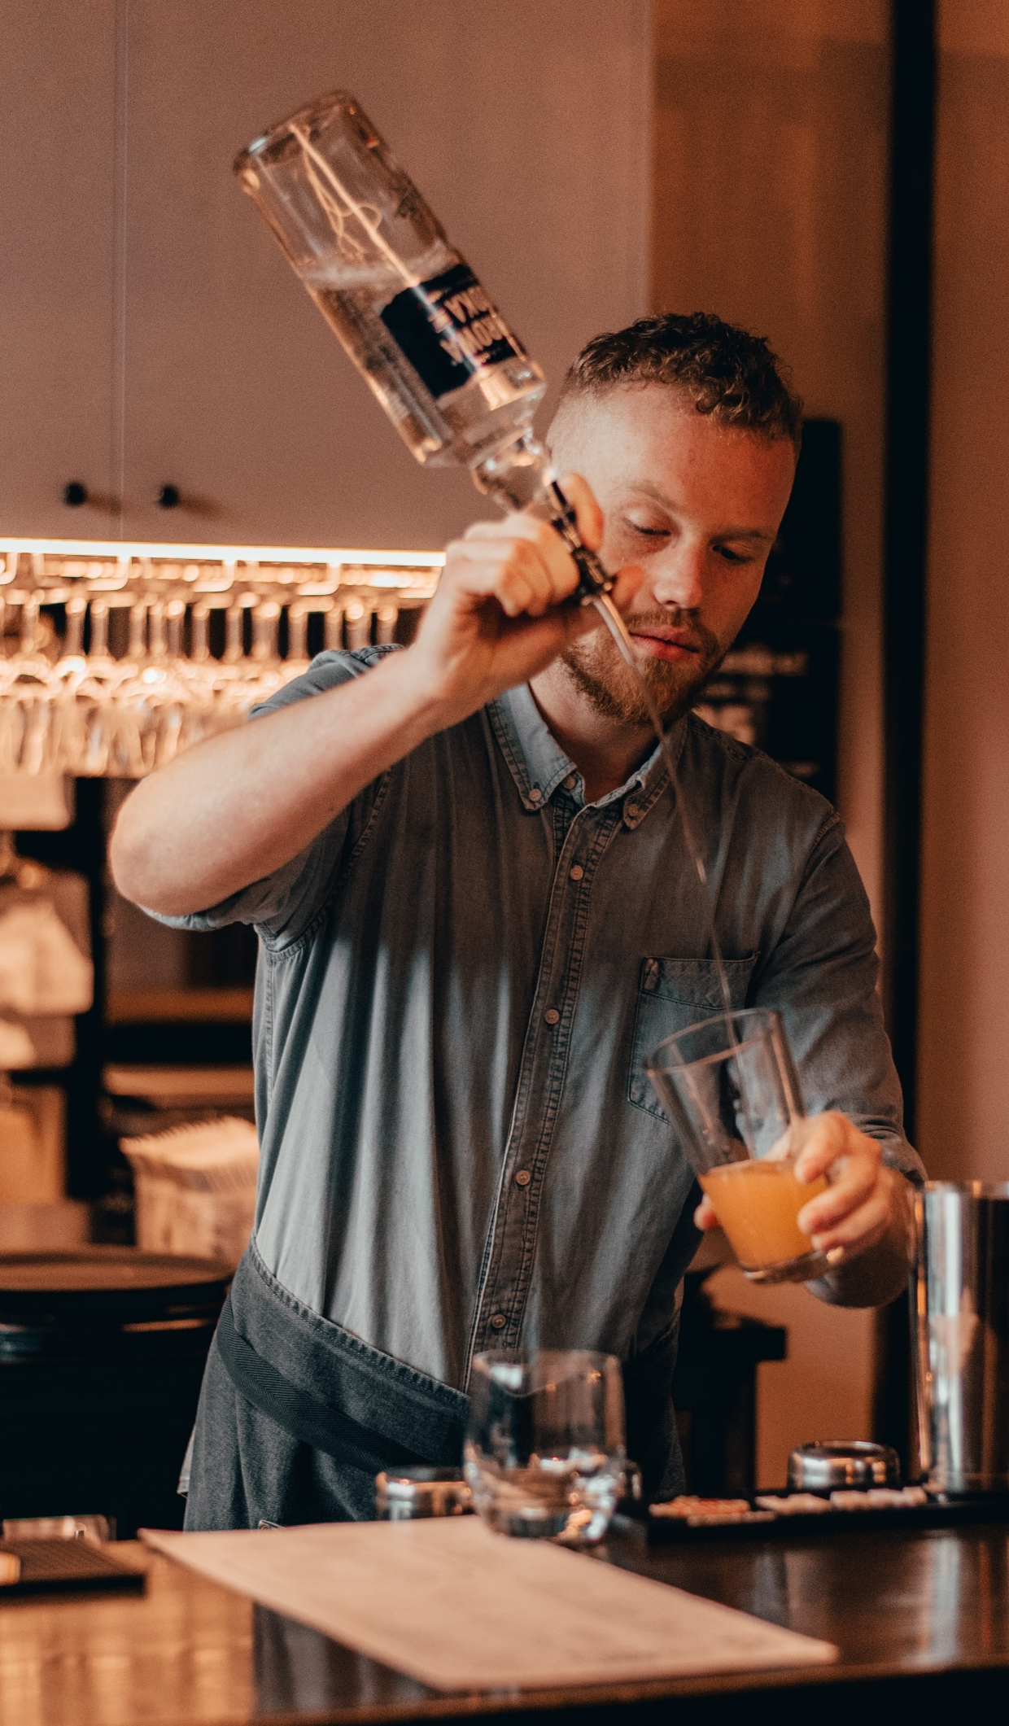
Global Bartender Reports
Market-specific insights based on a robust sample of 150 bartenders per country
Understand the market nuances and the needs of hospitality professionals at a market level by purchasing country-specific Bartender Report
Market-level reports are available for all countries included in the study and provide a rich insight into how to win with hospitality professionals, how to drive advocacy and the trends impacting specific countries
What you will receive
An in-depth report providing market level findings and recommendations allowing you to build relationships with this crucial audience, delivered in local language
A virtual presentation of findings, delivered by CGA experts
Investment
UK - $17,748 | USA - $22,185 | France - $16,417
South Korea - $17,526 | Italy - $16,417 | Mexico - $19,523
Germany - $19,967 | Australia - $17,525 | Canada - $17,748
Spain - $16,417

Slide 38
Want to know more about how global trends are currently impacting the German On Premise?
Global REACH Presentations | Regional REACH reports | OPUS Lite
At CGA, May marks the release of our annual Global On Premise insights report – REACH. Alongside the usual look at On Premise visitation, trending categories and venue choice factors, this year’s report looks the topical issues affecting the industry such as sustainability, the cost of living crisis, social media and advocacy, education and others. If you’d like to enquire about a presentation for you and your team, please get in touch via the contact information on the next slide. | Following on from our annual Global REACH report will be our regional REACH reports aiming to explore more closely the nuances by market dependent on global location. For the German On Premise this will be in the form of a dedicated European report. Get in touch to discuss the available options. | If you’d like something a little closer to home, 2023 see’s the launch of our OPUS Lite package, which provides market level insights on those trends impacting the On Premise globally. Flexible options are available to suit your teams needs, whether that be through a ready made insight report or full access to the data set. Get in touch to find out more.

Slide 39
Want to know more about the German On Premise?
OPUS Select | OPUS Core
If you'd like to investigate a more specific topic more tailored to you and your business, 2023 see's the launch of the OPUS Select package. This provides market level insights focussing on specific topics from... Channel/ Occasion deep dive Category overview Hot topic Custom Business Case Demographic deep dive And more! Get in touch to find out more. | OPUS Core subscription allows you to delve into the details of consumer behaviour in the On Premise, from granular detail about each channel, occasion and drink category, as well as identifying how key trends are impacting the industry. Get in touch to find out more.

Slide 40
BILAL KADDOURI
MIRIAM STIRNIMANN
BETH LARMER
CLIENT SOLUTIONS DIRECTOR
CLIENT SUCCESS & INSIGHT MANAGER
SENIOR CONSUMER RESEARCH EXECUTIVE
Bilal.Kaddouri@nielseniq.com
Miriam.Stirnimann@nielseniq.com
Beth.larmer@nielseniq.com
Click here to receive latest and exclusive insights from Germany On Premise directly to your inbox

