Slide 1
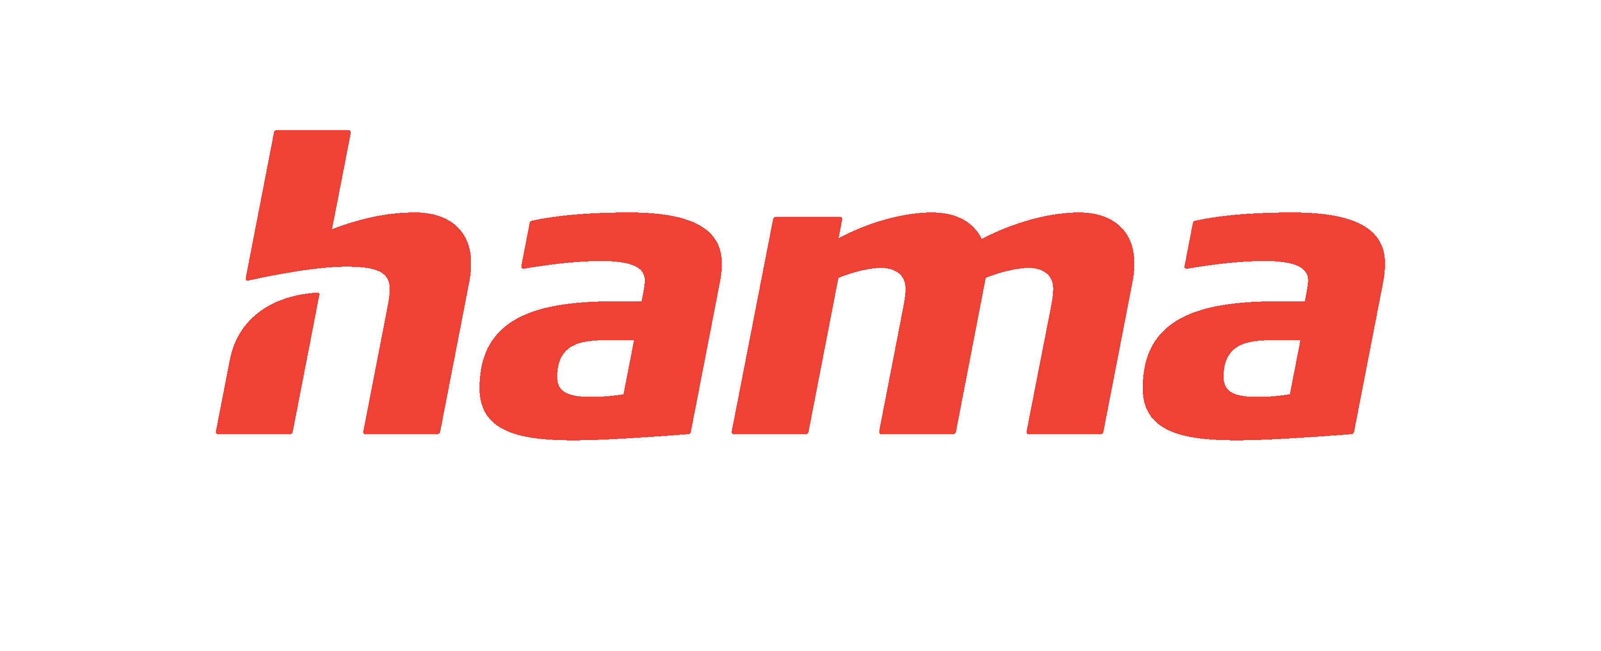
Elevating business decision-making
Hama relies on gfknewron Market to protect and grow market share
"Our collaboration with GfK has been invaluable and has significantly contributed to our success in the mobile phone accessories sector. Working together has enabled us to respond flexibly to the rapidly changing conditions and to strengthen our position. Maximizing the data and analytical capabilities of gfknewron Market has facilitated our daily work on product ranges and related decision-making. Quite simply, it has elevated our business decision-making to a new level.”
— ROBERT MOLENAAR, HEAD OF PRODUCT PORTFOLIO MOBILCOM, HAMA
Hama is a leading manufacturer and distributor of accessories for a range of consumer technology categories including mobile phones, photo, digital, audiovisual, multimedia, computer and telecommunications.
A working relationship rooted in trust
“Our partnership with GfK is built on trust and is supported by regular meetings and updates. As gfknewron Power Users, we appreciate the intensity at which we can work with the tool. In particular, the ability to have detailed data available at any time has significantly improved our analytical capabilities.”
— ROBERT MOLENAAR, HEAD OF PRODUCT PORTFOLIO MOBILCOM, HAMA
Find new opportunities to grow from data overload
As a player in the fast-moving mobile devices market, Hama needs to protect its existing market share and find new spaces to enhance its portfolio. Given the highly competitive nature of this sector, success means constantly analyzing emerging market trends and new technologies. Key to this intelligence gathering is monitoring competitors’ pricing, product portfolio, and promotions.
However, as the mobile enhancement market is so large, with a multitude of players, start-ups, products, launches and channels, information overload was becoming a challenge. Hama asked GfK to find a structured approach to monitor the numerous developments in its main market segment, freeing it to focus on relevant intelligence to respond both proactively and reactively to maintain its market position.
From identifying potential to executing campaigns
GfK worked closely with the team at Hama to customize the gfknewron tool to its needs. That included adding new product features and
filter options and offering segmentation alternatives to fine-tune the analytical capabilities.
Today, Hama’s product management, sales and marketing teams use gfknewron in many ways, including identifying new sector potential, designing the best product portfolio and assortments, planning go-to-market strategies, developing sales strategies, perfecting pricing and forecasting demand. In monthly check-in sessions with Hama’s product marketing team, use cases for data analyses are discussed and the platform is used to answer current business questions.
Harnessing intelligence to protect and grow market share
Through collaboration with GfK, and especially with the gfknewron Market Tool, Hama has been able to pursue a structured approach to intelligence gathering to keep track of the many factors that influence the business. The close relationship and joint development of the gfknewron tool have been a significant benefit to the company.
Key facts for Hama
Sector: Consumer Electronics
HQ: Monheim, Germany
Employees: 2500

